Slide 1
Lesson Two: Setting up an Opening Scene – This is an opportunity to begin building your own world!

Slide 2
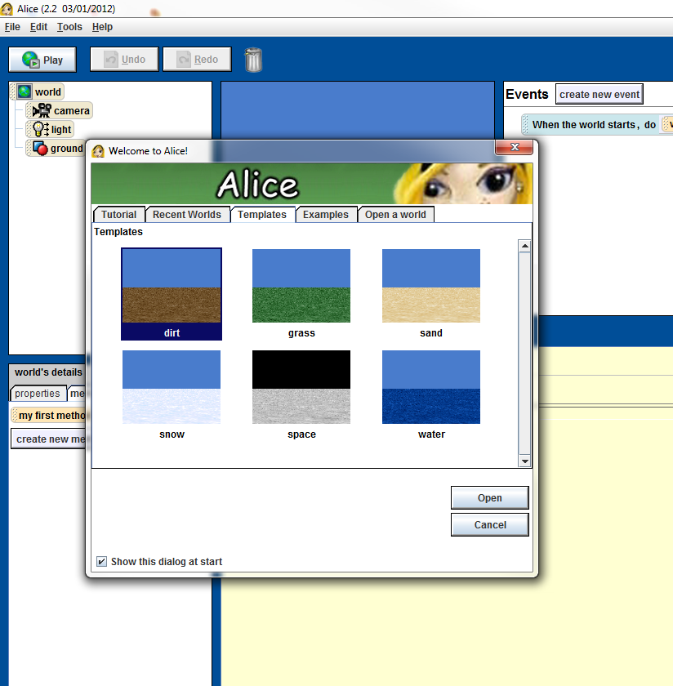
Step 1: Create a New Alice World
Open Alice like you did in Lesson Zero, but this time click on the dirt-template world.

